Slide 1

CODECAST
Supporting Data Driven In-Network Processing for
Low-Power Wireless Sensor Networks
Mobashir Mohammad Mun Choon Chan

Slide 2
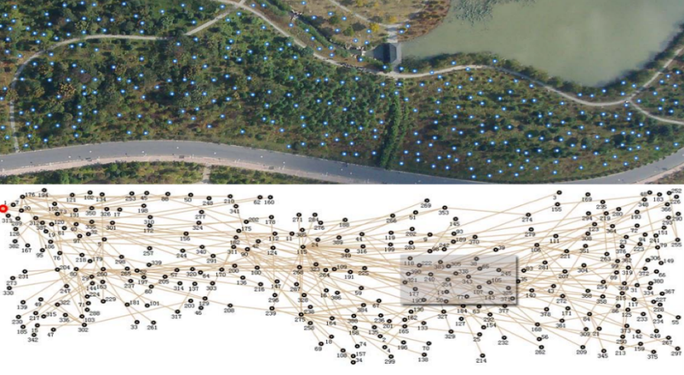

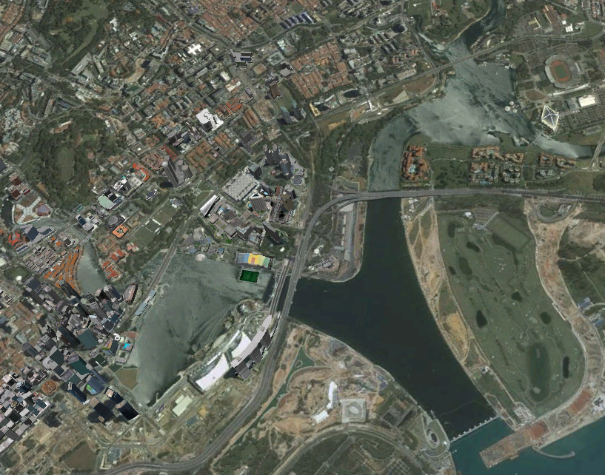
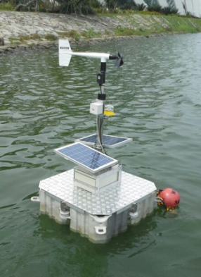

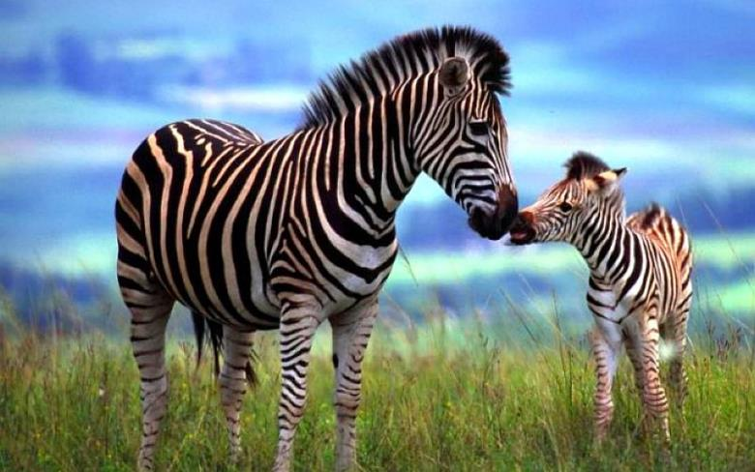
Some WSN Deployments
GreenOrbs [Y. Liu et al.]
Golden Gate Bridge [S. Kim et al.]
Water Reservoir [W. Du et al.]
_{3km}
Volcano [G. Werner-Allen et al.]
_{1 km}
ZebraNet [T. Liu et al.]
_{2.5km}
Notes:
There has been very interesting deployments. Most often when we talk about wireless sensor network, we end up targeting applications that require collecting information to common central point called the gateway.

Slide 3
Communication Service Providers
Notes:
And there have been many successful commercial solutions to enable such applications

Slide 4
Emerging Applications
Distributed Channel Selection
Notes:
There is a need for many-to-many communication for many emerging applications. For instance, distributed channel selection where each node individually decides which set of channel to use

Slide 5
Emerging Applications
Link state routing for Sensor Network
Notes:
Or a link state-based routing for low power wsn where each node needs to be aware of the entire network topology

Slide 6
Emerging Applications
Single Solution for Diverse Traffic Requirements
Notes:
Or even a single solution to handle multiple traffic patterns

Slide 7
Existing Approaches
Collection Driven (CTP + Glossy)
Collection the data/decision of every node
Process the consensus at the central sink
Disseminate the consensus
Low Power Wireless Bus (LWB)
Perform periodic dissemination sourced at every network node
Chaos
Solves ”Leader Election” Problem
SLOW…!
UNRELIABLE…!
LOW THROUGHPUT…!
Notes:
Existing approaches include…

Slide 8
Existing Approaches
Collection Driven (CTP + Glossy)
Collection the data/decision of every node
Process the consensus at the central sink
Disseminate the consensus
Dissemination Driven (LWB)
Perform periodic dissemination sourced at every network node
Chaos
Solves ”Leader Election” Problem
SLOW…!
UNRELIABLE…!
LOW THROUGHPUT…!
Notes:
Existing approaches include…

Slide 9
Existing Approaches
Collection Driven (CTP + Glossy)
Collection the data/decision of every node
Process the consensus at the central sink
Disseminate the consensus
Dissemination Driven (LWB)
Perform periodic dissemination sourced at every network node
Chaos
Solves “Leader Election” Problem
SLOW…!
UNRELIABLE…!
RESTRICTED…!
Notes:
Chaos does a more specific leader…

Slide 10
Codecast
A
High throughput
Reliable
Low latency
Many-to-Many communication protocol

Slide 11
Codecast: Toy Example

Slide 12
Simple Multicast

Slide 13
Network Coding

Slide 14
Codecast

Slide 15
Codecast
Alternating Synchronous TX/RX
Allow multiple nodes to transmit together
Capture effect allows successful packet RX

Slide 16

Capture Effect
P_{D}
D
P_{A}
R
P_{C}
A
P_{B}
C
B
P_{A} >> P_{A}+ P_{B}+ P_{C}

Slide 17
Codecast
Key Techniques
What to transmit?
Improve throughput
When to transmit?
Reduce packet collisions
How to terminate?
Reduce energy consumption

Slide 18
Codecast
Key Techniques
What to transmit?
Improve throughput
When to transmit?
Reduce packet collisions
How to terminate?
Reduce energy consumption

Slide 19
Background
Fountain Code
Data to Share
{D₁, D₂, … , D_{n}}
{D₂⊕D₄}
{D₁⊕D₃⊕D₅}
Degree?
Encoder
{D₁}
Packet received successfully
Packets corrupted/dropped
Notes:
Network Coded Data Distribution

Slide 20
Degree Distributions
Soliton Distribution

Slide 21
Degree Distributions
Robust Soliton Distribution

Slide 22
Degree Distributions
Growth Code Distribution
Notes:
All of these distributions work fine when the data is confined at a single source

Slide 23
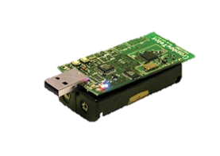
Degree Distributions Good Enough?
Growth Code
Soliton
Robust Soliton
#Total = 30
#A = 15
#B = 14
#K = 12
Node A
Node B
Notes:
A helping B
Soliton 2
Robust Soliton 2, 10
GC 1

Slide 24
NANC - Network Assisted Network Coding
Basic Idea
Degree of the Codeword?
#Total = N
#A = a
#B = b
#K = k_{i}
Node A
Node B
Notes:
Everyone keep record of the decoding progress of its neighbors.
Identifies the slowest neighbor and select the degree that maximized the decoding probability of the slowest neighbor
This heuristic helps to avoid the long tail in data sharing – everyone gets the data sort of together.

Slide 25
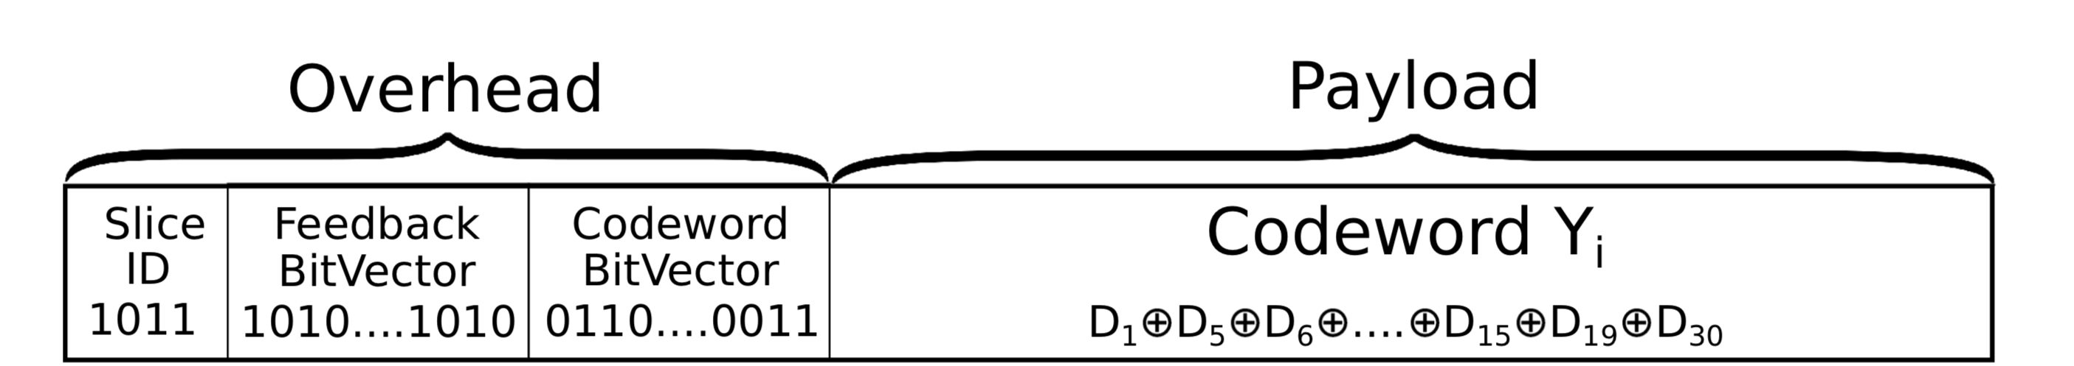
NANC - Network Assisted Network Coding
Basic Idea
Craft a specialized Codeword
s bits
N bits
N bits
128 bytes - Overhead

Slide 26
Codecast
Key Techniques
What to transmit?
Improve throughput
When to transmit?
Reduce packet collisions
How to terminate?
Reduce energy consumption

Slide 27
Codecast
When to transmit?
TX = function(I’m Done, Others Done, Decoded New)
I’m Done | Others Done | Decoded New | Transmit | Remarks
0 | 0 | 0 | P | Probabilistic transmission to avoid collisions.
0 | 0 | 1 | 1 | Leaned a new symbol, share with neighbors.
0 | 1 | 0 | 1 | Only I need a symbol, inform neighbors.
0 | 1 | 1 | 1 | Only I need a symbol, inform neighbors.
1 | 0 | 0 | P | Probabilistic transmission to avoid collisions.
1 | 0 | 1 | 0 | Not possible. Cannot learn a new symbol after I’m done.
1 | 1 | 0 | 0 | Everyone has terminated. Stop transmission.
1 | 1 | 1 | 0 | Not possible. Cannot learn a new symbol after I’m done.
Notes:
P = 0.1
Whenever I learn something new, I transmit
Whenever I have not learnt anything new, I probabilistically transmit

Slide 28
Codecast
When to transmit?
TX = function(I’m Done, Others Done, Decoded New)
I’m Done | Others Done | Decoded New | Transmit | Remarks
0 | 0 | 0 | P | Probabilistic transmission to avoid collisions.
0 | 0 | 1 | 1 | Leaned a new symbol, share with neighbors.
0 | 1 | 0 | 1 | Only I need a symbol, inform neighbors.
0 | 1 | 1 | 1 | Only I need a symbol, inform neighbors.
1 | 0 | 0 | P | Probabilistic transmission to avoid collisions.
1 | 0 | 1 | 0 | Not possible. Cannot learn a new symbol after I’m done.
1 | 1 | 0 | 0 | Everyone has terminated. Stop transmission.
1 | 1 | 1 | 0 | Not possible. Cannot learn a new symbol after I’m done.
Notes:
P = 0.1
Whenever I learn something new, I transmit
Whenever I have not learnt anything new, I probabilistically transmit

Slide 29
Codecast
When to transmit?
TX = function(I’m Done, Others Done, Decoded New)
I’m Done | Others Done | Decoded New | Transmit | Remarks
0 | 0 | 0 | P | Probabilistic transmission to avoid collisions.
0 | 0 | 1 | 1 | Leaned a new symbol, share with neighbors.
0 | 1 | 0 | 1 | Only I need a symbol, inform neighbors.
0 | 1 | 1 | 1 | Only I need a symbol, inform neighbors.
1 | 0 | 0 | P | Probabilistic transmission to avoid collisions.
1 | 0 | 1 | 0 | Not possible. Cannot learn a new symbol after I’m done.
1 | 1 | 0 | 0 | Everyone has terminated. Stop transmission.
1 | 1 | 1 | 0 | Not possible. Cannot learn a new symbol after I’m done.
Notes:
P = 0.1
Whenever I learn something new, I transmit
Whenever I have not learnt anything new, I probabilistically transmit

Slide 30
Codecast
When to transmit?
TX = function(I’m Done, Others Done, Decoded New)
I’m Done | Others Done | Decoded New | Transmit | Remarks
0 | 0 | 0 | P | Probabilistic transmission to avoid collisions.
0 | 0 | 1 | 1 | Leaned a new symbol, share with neighbors.
0 | 1 | 0 | 1 | Only I need a symbol, inform neighbors.
0 | 1 | 1 | 1 | Only I need a symbol, inform neighbors.
1 | 0 | 0 | P | Probabilistic transmission to avoid collisions.
1 | 0 | 1 | 0 | Not possible. Cannot learn a new symbol after I’m done.
1 | 1 | 0 | 0 | Everyone has terminated. Stop transmission.
1 | 1 | 1 | 0 | Not possible. Cannot learn a new symbol after I’m done.
Notes:
P = 0.1
Whenever I learn something new, I transmit
Whenever I have not learnt anything new, I probabilistically transmit

Slide 31
Codecast
Key Techniques
What to transmit?
Improve throughput
When to transmit?
Reduce packet collisions
How to terminate?
Reduce energy consumption

Slide 32

Codecast
Integrate with Chaos
Each node set its bit in the Termination Flag when done
Transmits 5 times aggressively when all the bits are set
Turn the radio off
Termination BitVector 1100….1011

Slide 33
Evaluation
Compared against
LWB – Low Power Wireless Bus
Chaos
Testbeds considered
Indriya at NUS - 90 nodes across 3 floors of a building
Flocklab at ETH - 30 nodes indoor and outdoor
Notes:
5-6 Hope network diameter

Slide 34
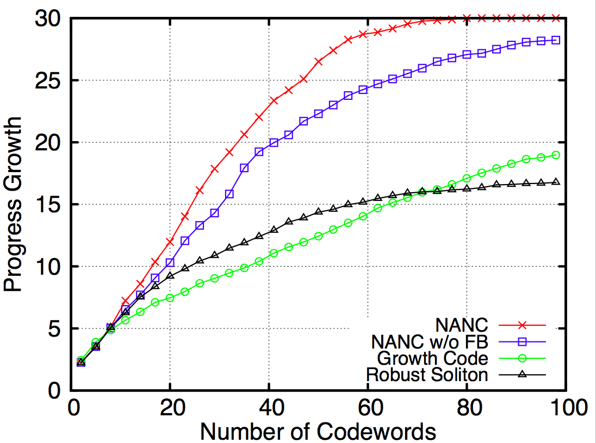
Evaluation
Network Code Performance
Coupon Collector Problem
Notes:
Conducted on Indriya

Slide 35
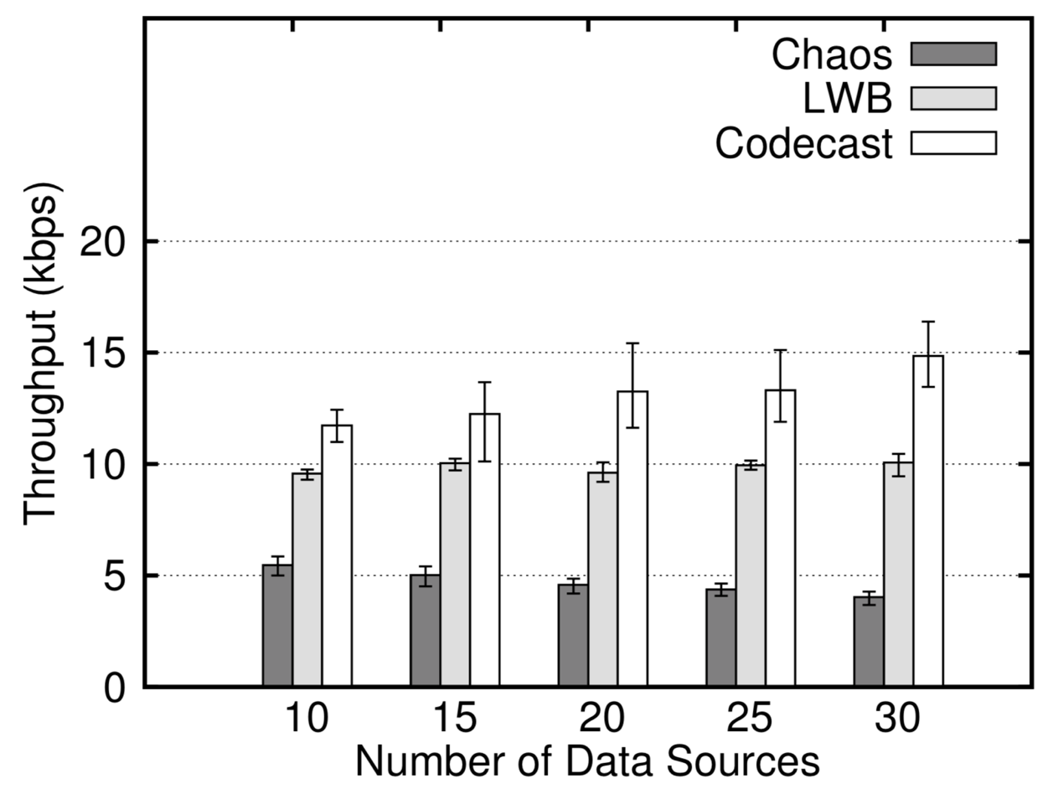
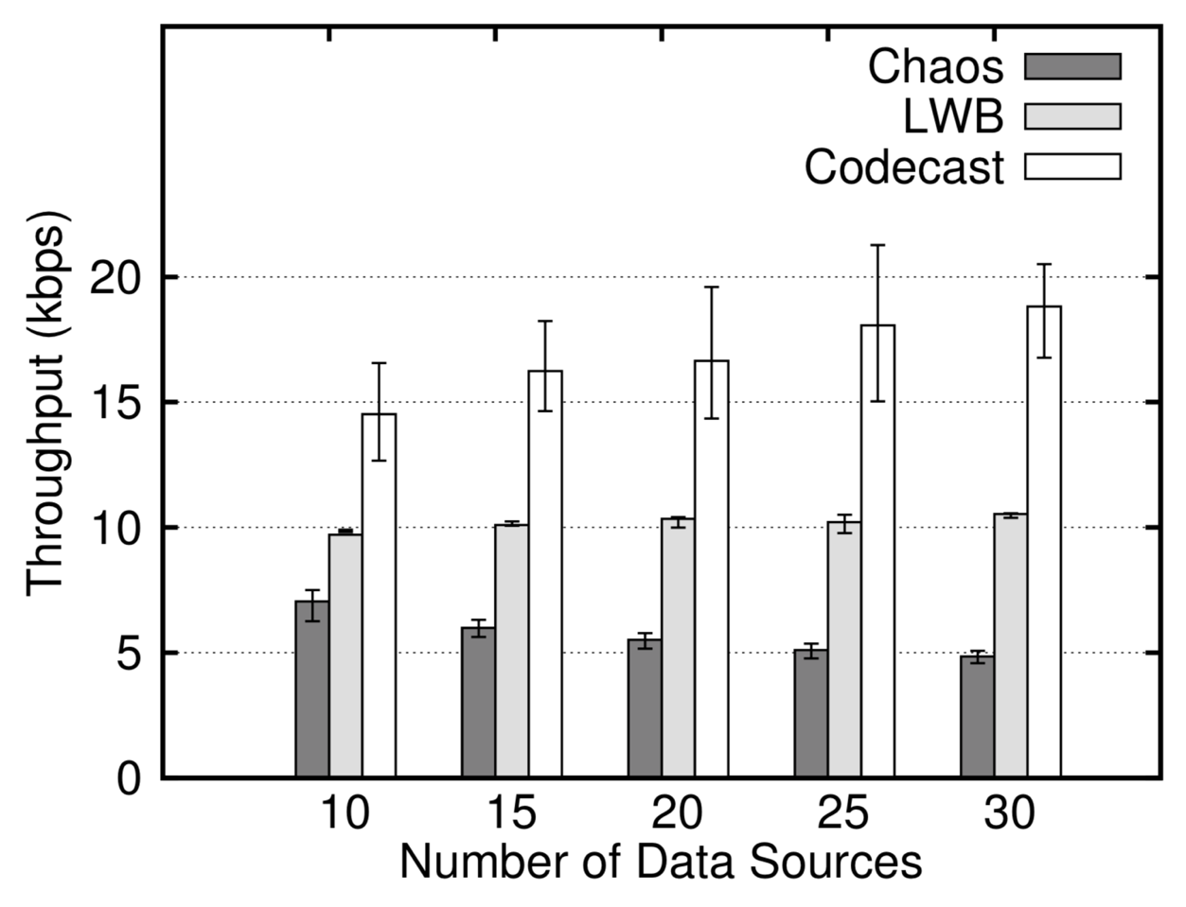
Many-to-Many Data Sharing
Impact of Varying Data Sources
Indriya
Flocklab
Codecast is up to 1.9x and up to 4.2x the throughput of LWB and Chaos respectively

Slide 36
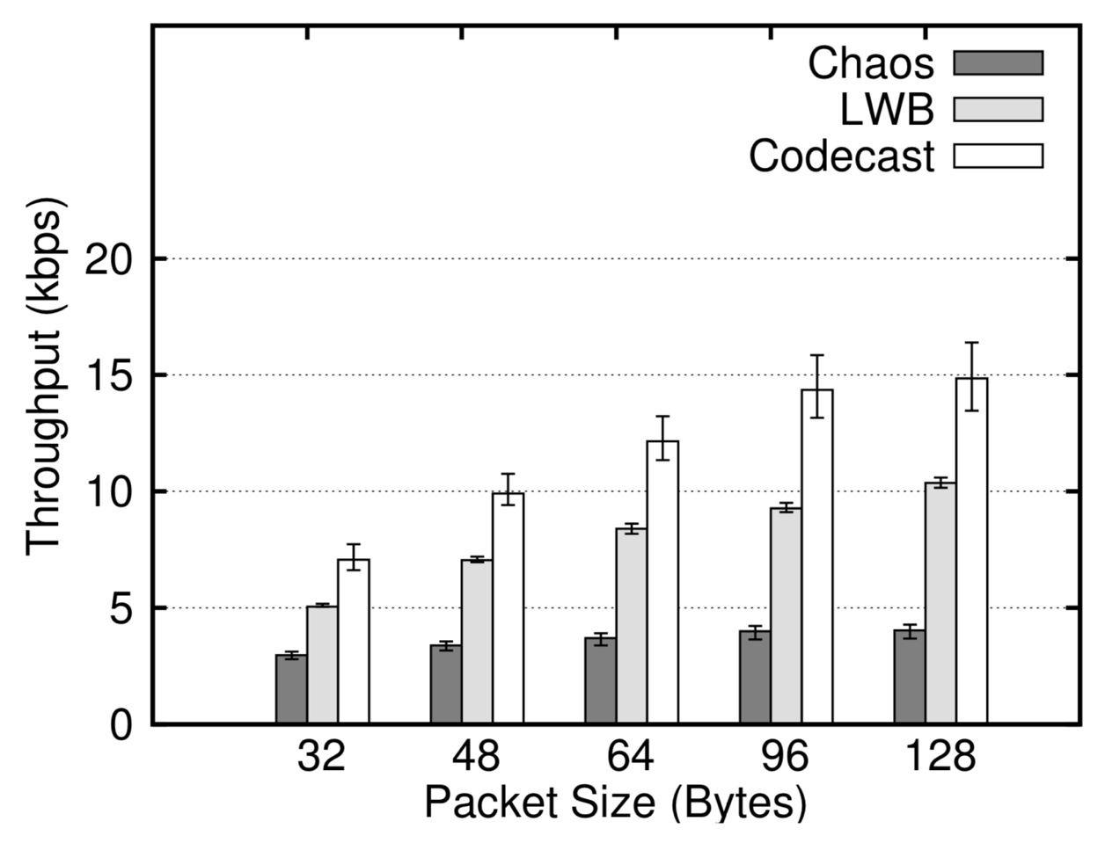
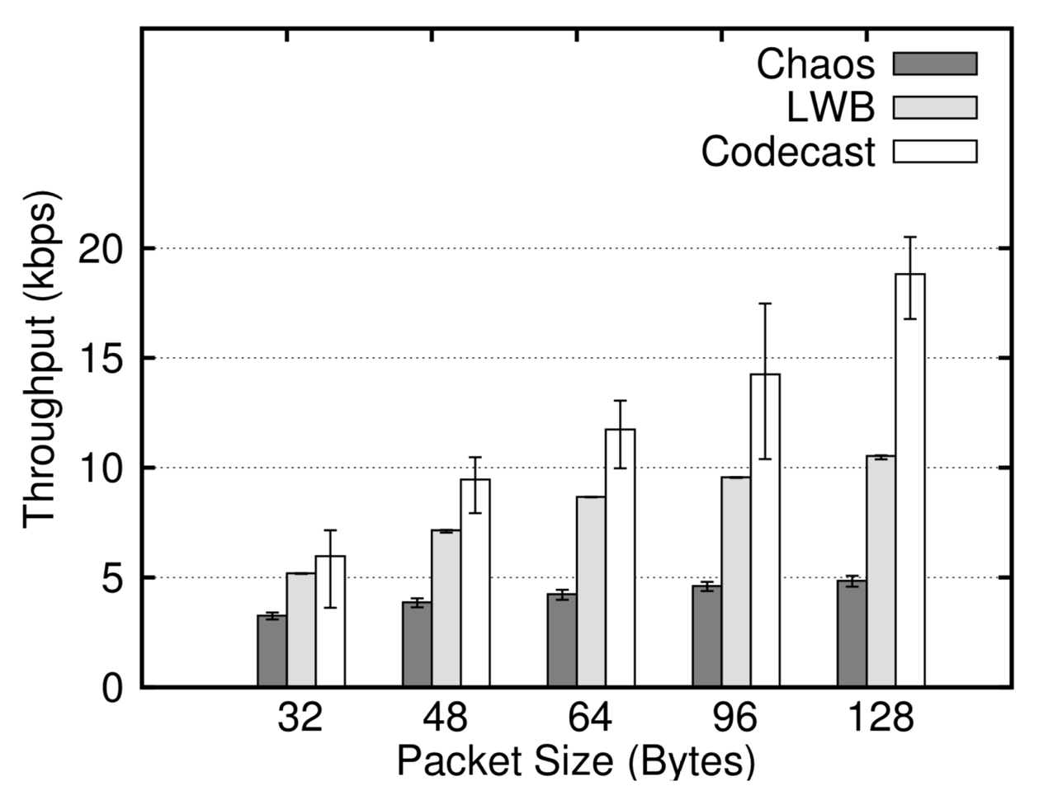
Many-to-Many Data Sharing
Impact of Varying Packet Sizes
Indriya
Flocklab
Large sized packets show up to 3x the throughput than smaller sized packets

Slide 37
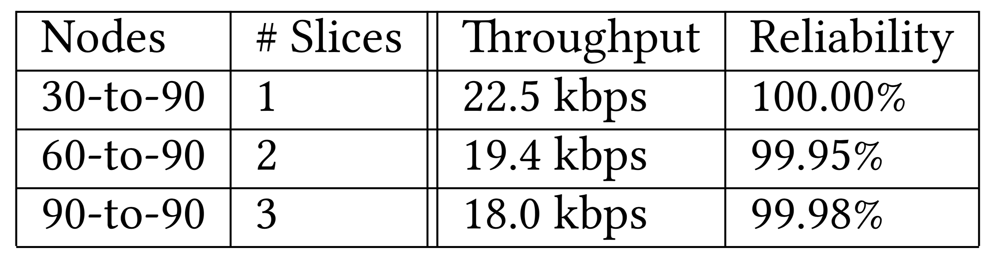
Many-to-Many Data Sharing
Scaling to the network

Slide 38
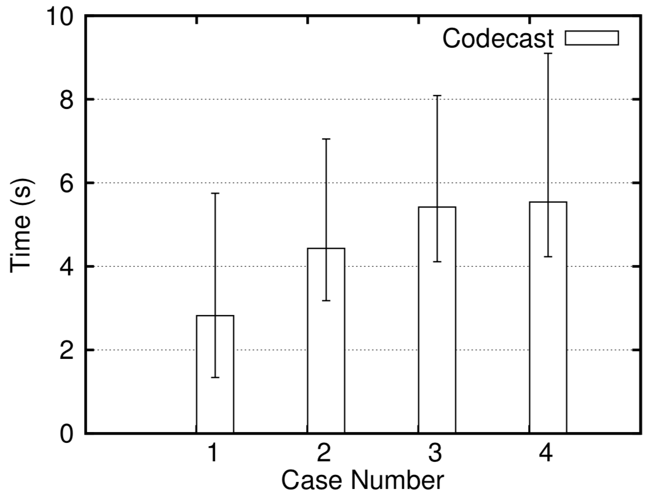
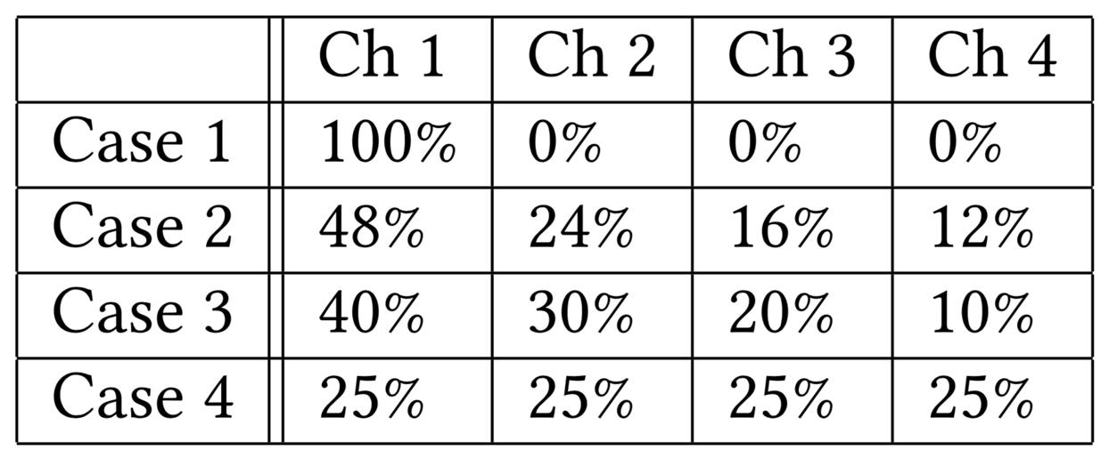
Applications
Distributed Channel Selection
Channel selection scheme

Slide 39
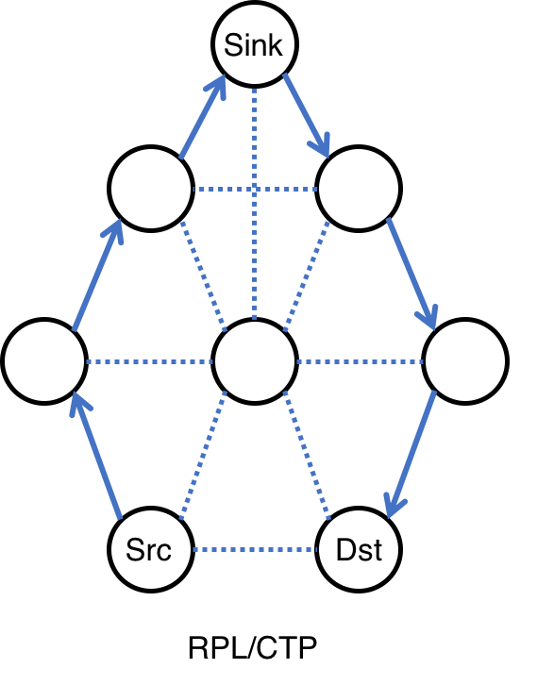
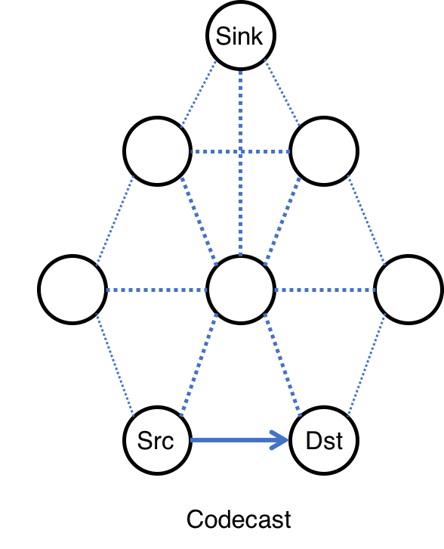
Applications
Routing for Sensor Networks

Slide 40
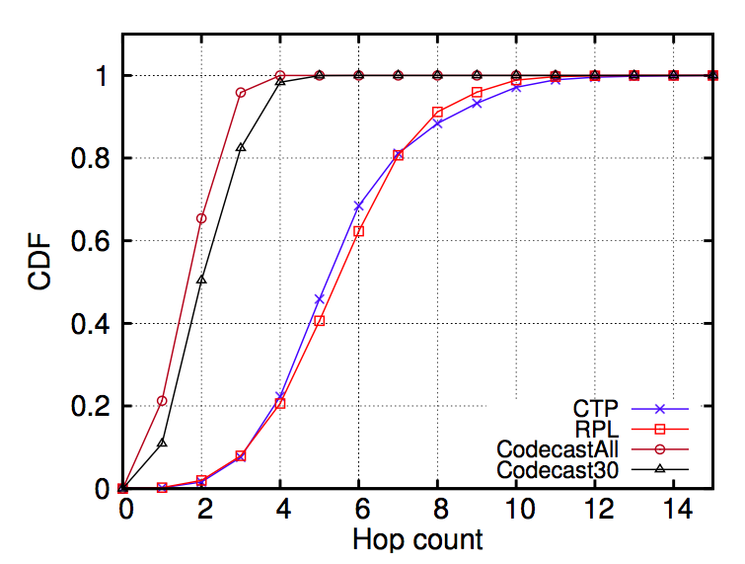
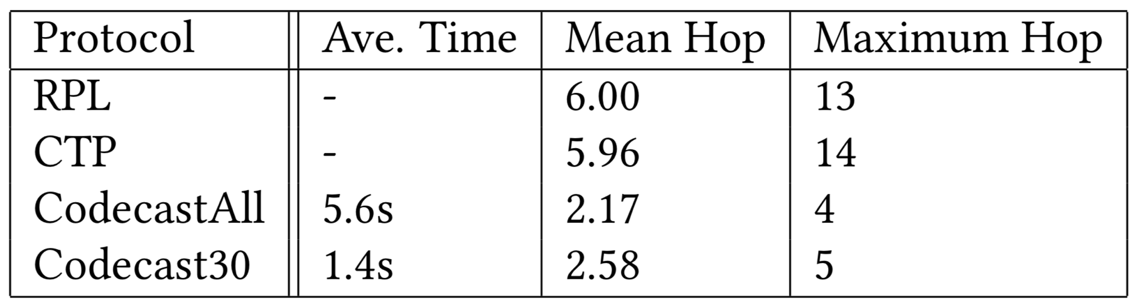
Applications
Routing for Sensor Networks

Slide 41
Summary of Codecast
An improved network coding degree selection using network feedback
Contiki implementation with real testbed experiments
Reliable many-to-many communication
Up to 4.2x throughput improvement over state-of-the-art
Built multiple applications leveraging Codecast
Distributed Channel Select, Routing for WSN, etc.

Slide 42


